Slide 1

Geometry
Unit 9, Lesson 4 Solids of Rotation Volume 2, pg. 70

Slide 2


Benchmark
MA.912.GR.4.2
Identify three-dimensional objects generated by rotations of two-dimensional figures.
volume 2, pg. 70

Slide 3
Integrated Mathematical Thinking and Reasoning Standards
MA.K12.MTR.1.1 Actively participate in effortful learning both individually and collectively.
MA.K12.MTR.2.1 Demonstrate understanding by representing problems in multiple ways.
MA.K12.MTR.4.1 Engage in discussions that reflect on the mathematical thinking of self and others.
volume 2, pg. 70

Slide 4

Learning Target
I can identify three-dimensional objects generated by rotations of two-dimensional figures.
volume 2, pg. 70

Slide 5

Warm-Up
volume 2, pg. 71

Slide 6
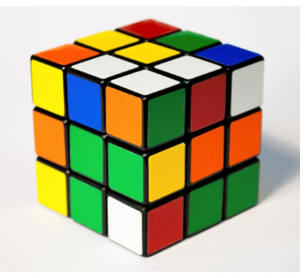
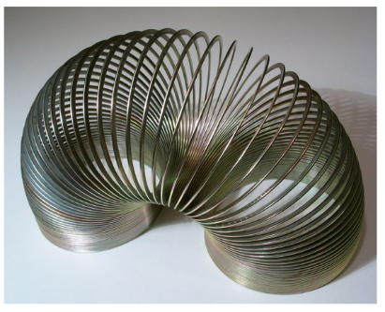
9.4.1 Warm-Up: Notice and Wonder
A Rubik’s Cube and a Slinky are shown.
What do you notice?
What do you wonder?
Sketch the horizontal cross section of the Rubik’s cube.
Sketch the horizontal cross section of the Slinky.
volume 2, pg. 71

Slide 7

Activity
volume 2, pg. 71

Slide 8

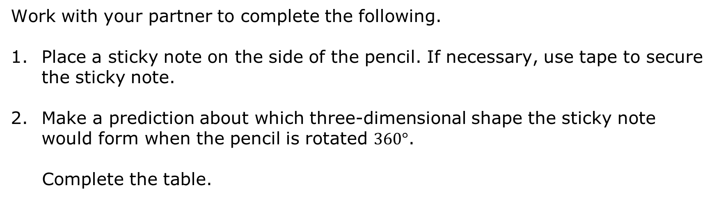
9.4.2 Activity: Rotating Pencils
Work with your partner to complete the following.
Place a sticky note on the side of the pencil. If necessary, use tape to secure the sticky note.
Make a prediction about which three-dimensional shape the sticky note would form when the pencil is rotated $360°$.
Complete the table.
Sticky Note | Prediction | Reasoning
volume 2, pg. 71

Slide 9
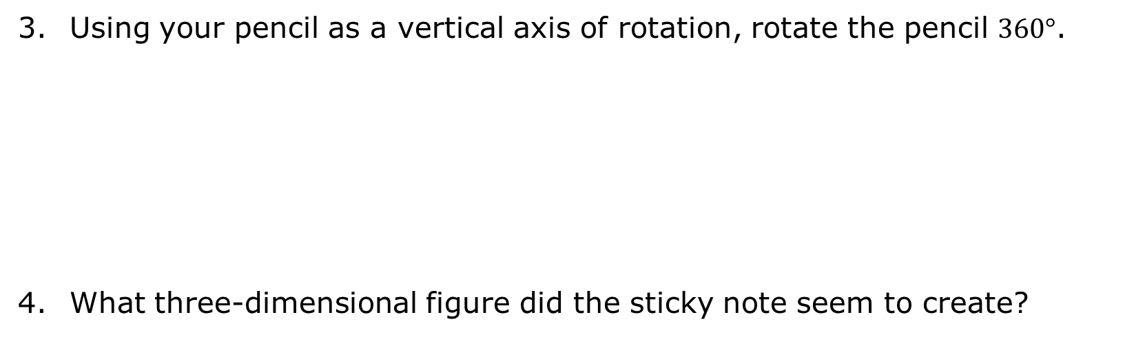
Using your pencil as a vertical axis of rotation, rotate the pencil $360°$.
What three-dimensional figure did the sticky note seem to create?
volume 2, pg. 71

Slide 10
Work with your partner to predict what three-dimensional shape will be formed when each shape is rotated $360°$.
Shape | Prediction | Reasoning
Rectangle
Triangle
Semicircle
volume 2, pg. 72

Slide 11
Using your pencil as a vertical axis of rotation, rotate the pencil $360°$. Then, sketch or describe the resulting three-dimensional shape.
Shape | Three-Dimensional Shape
Rectangle
Triangle
Semicircle
volume 2, pg. 72

Slide 12
Discuss with your partner whether the three-dimensional shape would be different if the pencil were held horizontally instead of vertically. Summarize your discussion.
Draw any four-sided, two-dimensional shape on a 3x5 card. Make it as unique as possible. Cut out your shape. Draw the outline of your shape below.
volume 2, pg. 72

Slide 13
Sketch what you think the three-dimensional figure of your four-sided two-dimensional shape will look like if rotated around each axis.
Horizontal Axis | Vertical Axis
volume 2, pg. 73

Slide 14
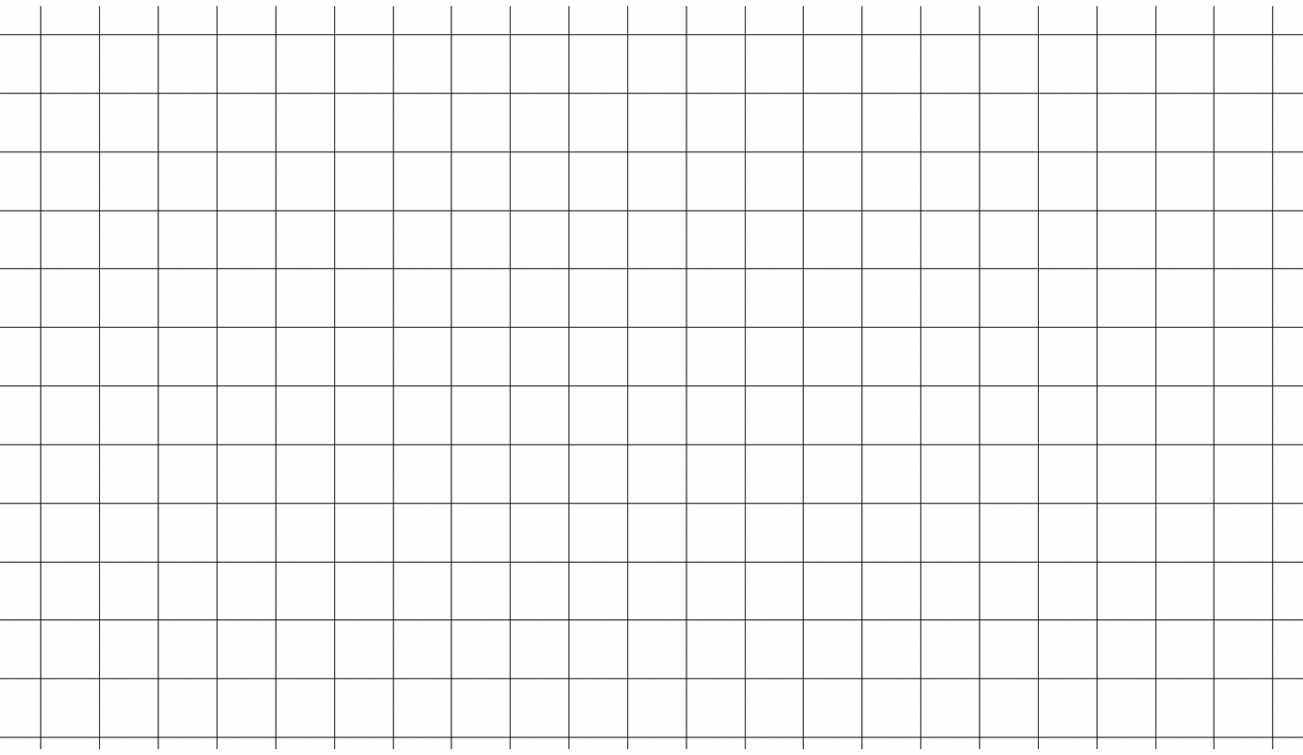
Review your partner’s shape. Then, complete the following.
Draw your partner’s shape on the grid below.
Draw a horizontal axis of rotation.
Draw the reflection of your partner’s shape.
volume 2, pg. 73

Slide 15
Discuss with your partner how drawing a reflection could help envision the three-dimensional figure. Summarize your discussion.
Sketch what you think the three-dimensional figure of your partner’s four-sided, two-dimensional shape will look like if rotated around each axis.
Compare your sketches with your partner. Discuss any differences and make any adjustments.
Horizontal Axis | Vertical Axis
volume 2, pg. 73

Slide 16

Guided Instruction
volume 2, pg. 74

Slide 17
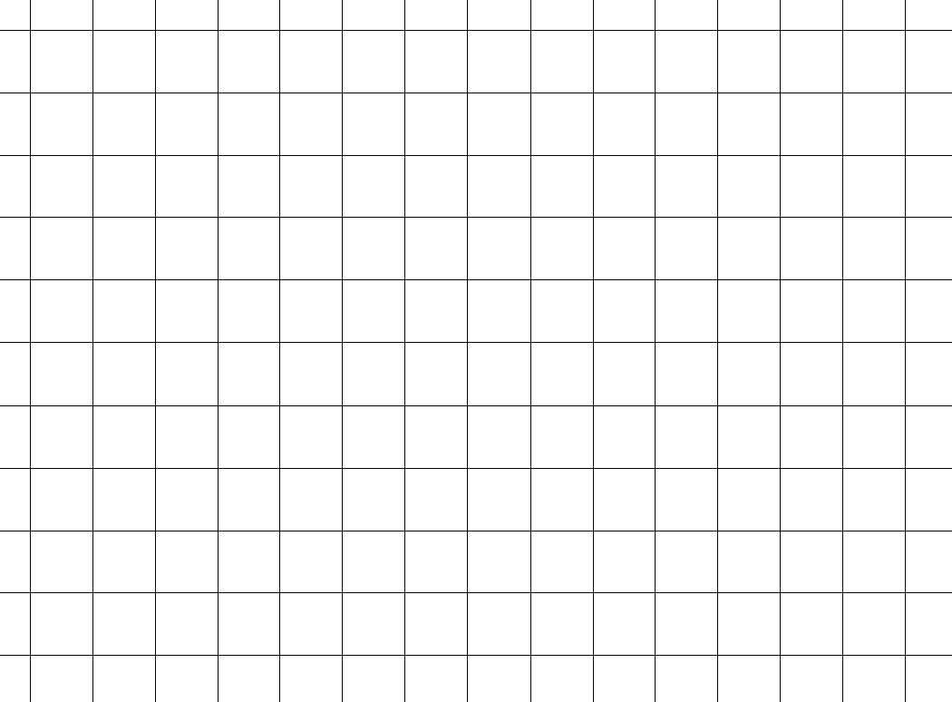
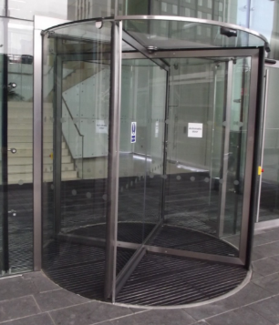
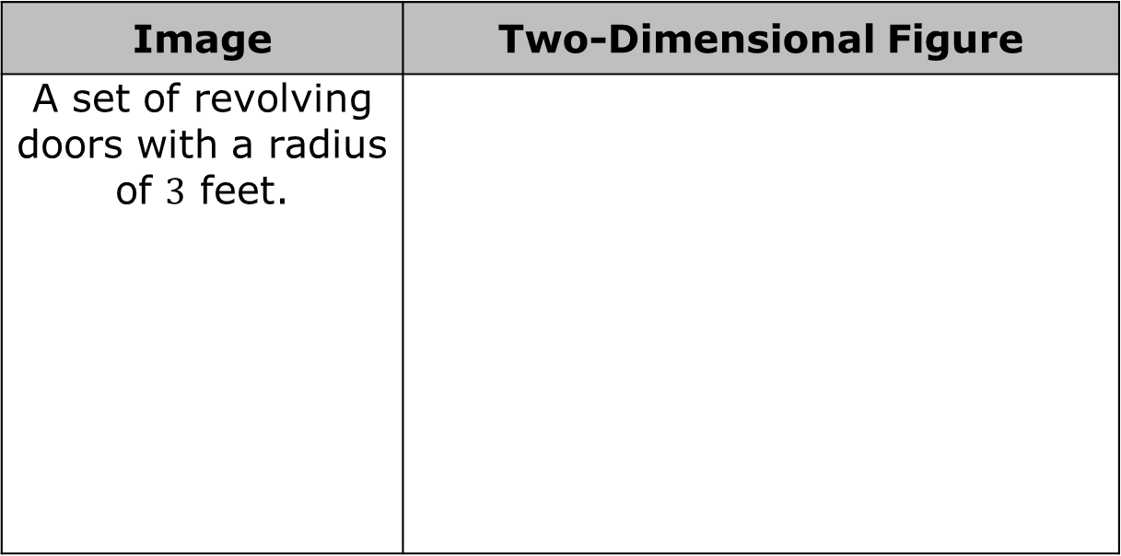
9.4.3 Guided Instruction: Rotations with Dimensions
Draw a two-dimensional figure and an axis of rotation that would result in the real-world object when the two-dimensional figure is rotated around the axis of rotation.
Image | Two-Dimensional Figure
A set of revolving doors with a radius of $3$ feet.
volume 2, pg. 74

Slide 18
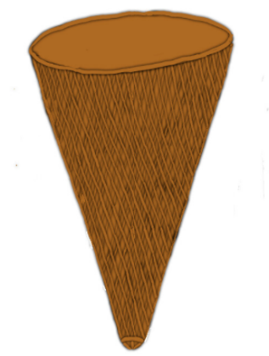

Image | Two-Dimensional Figure
An ice cream cone with a diameter of $4.5$ centimeters (cm) and a height of $11$ cm.
volume 2, pg. 74

Slide 19
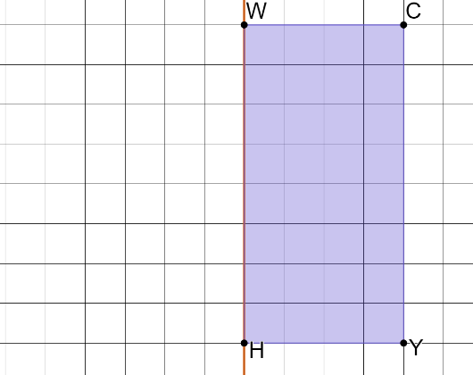
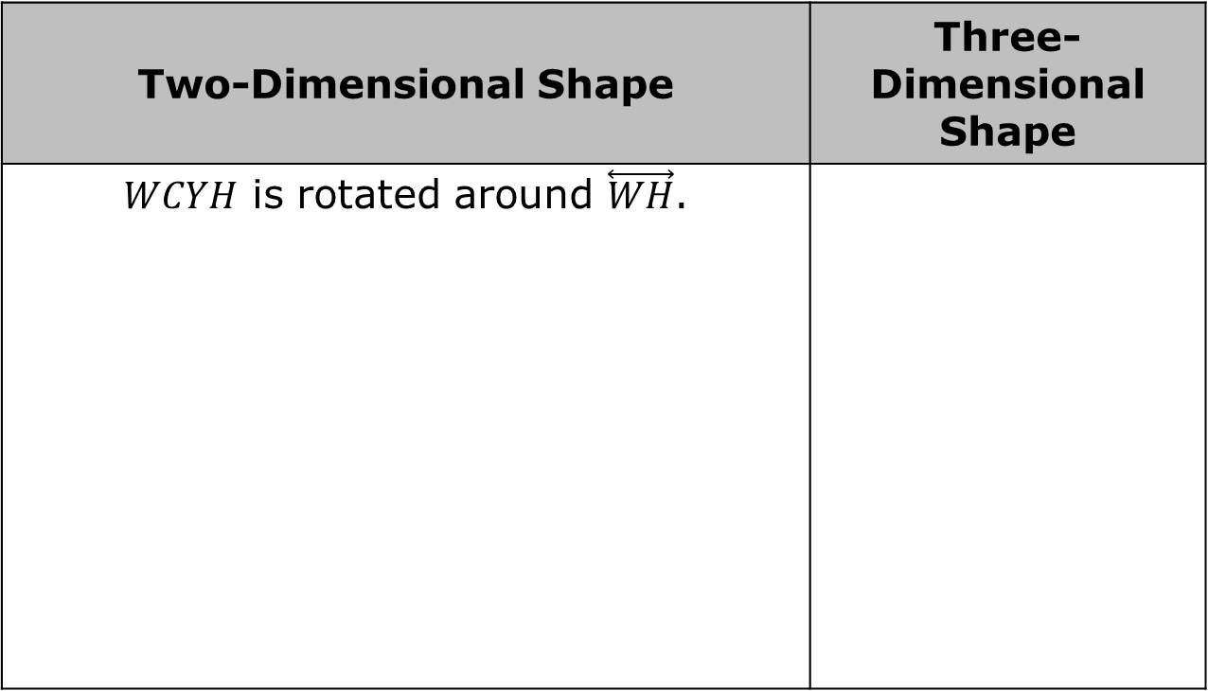
Sketch the three-dimensional shape that is created. Include any dimensions in units.
Two-Dimensional Shape | Three-Dimensional Shape
$WCYH$ is rotated around $\overset{⃡}{WH}$.
volume 2, pg. 74

Slide 20
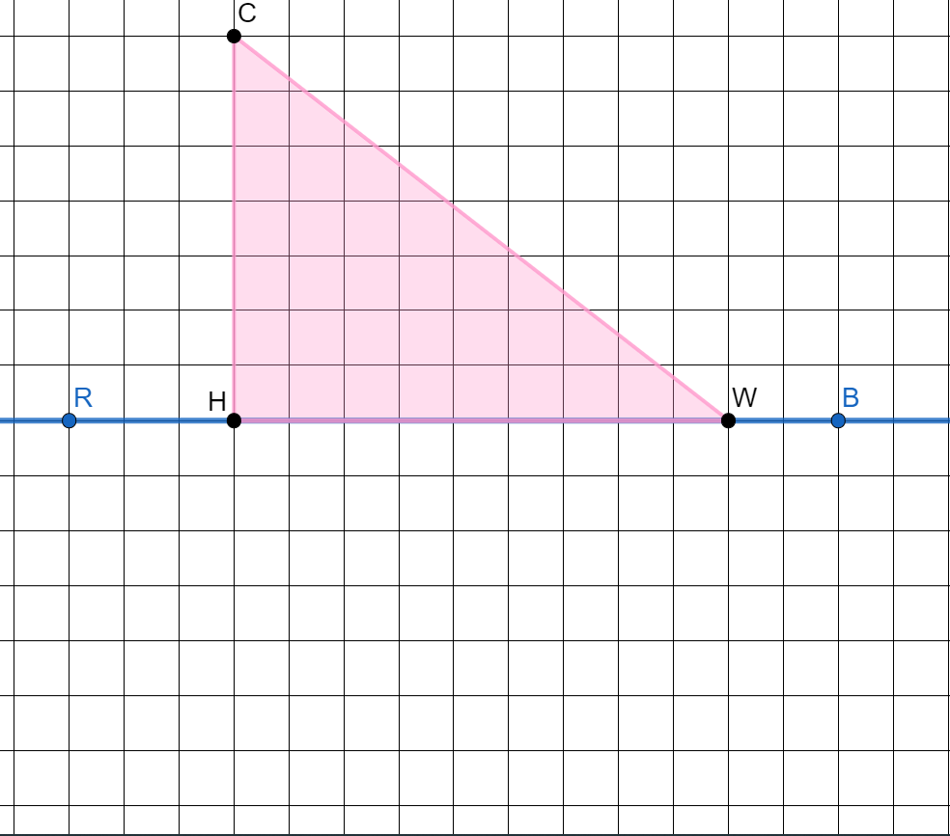
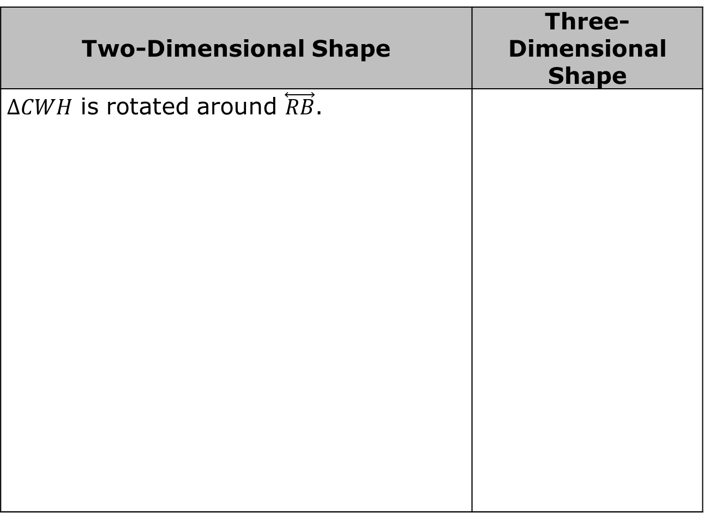
Two-Dimensional Shape | Three-Dimensional Shape
$∆CWH$ is rotated around $\overset{⃡}{RB}$.
volume 2, pg. 74

Slide 21

Guided Practice
volume 2, pg. 75

Slide 22

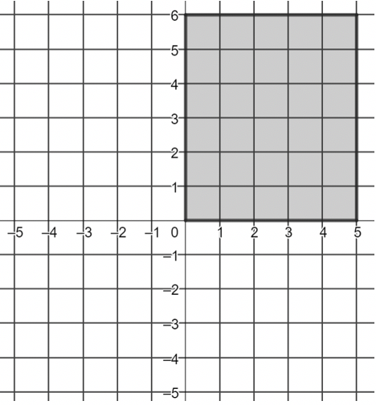
9.4.4 Guided Practice: Rotations
Describe and sketch the three-dimensional shape that is created when the rectangle is rotated around the $y$‑axis. Include any known dimensions.
volume 2, pg. 75

Slide 23
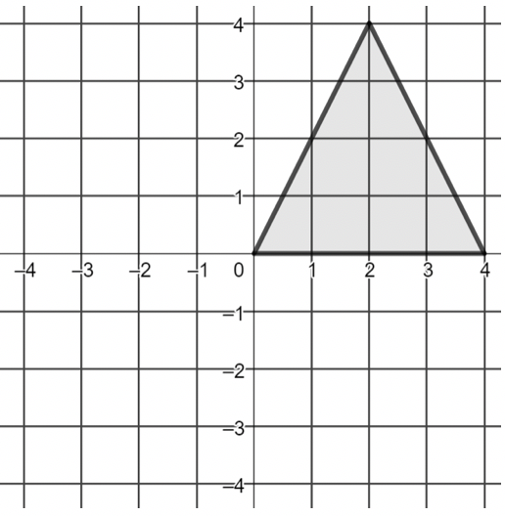
Describe and sketch the three-dimensional shape that is created when the isosceles triangle is rotated around the $y$-axis. Include any known dimensions.
volume 2, pg. 75

Slide 24

Wrap-Up
volume 2, pg. 75

Slide 25
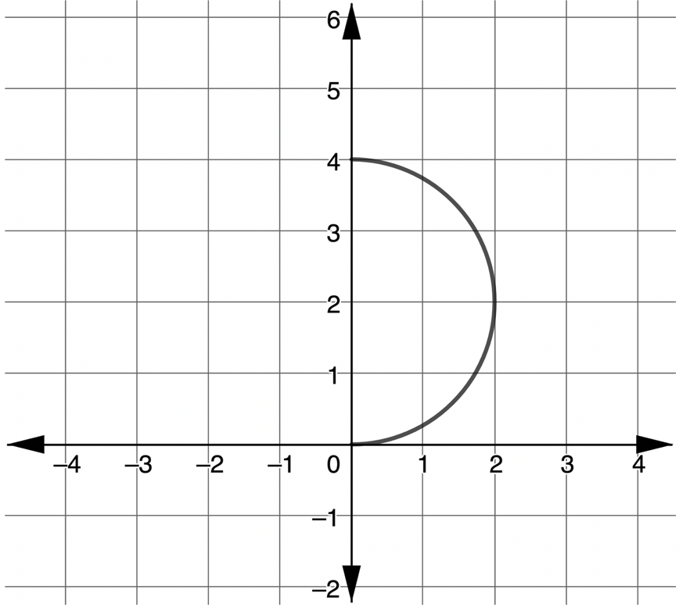
9.4.5 Wrap-Up: Ticket Out the Door
Describe and sketch the three-dimensional shape that is created when the semicircle is rotated around its diameter. Include any known dimensions.
volume 2, pg. 75

